Slide 1
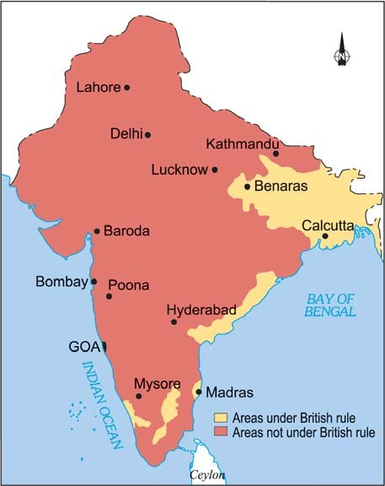
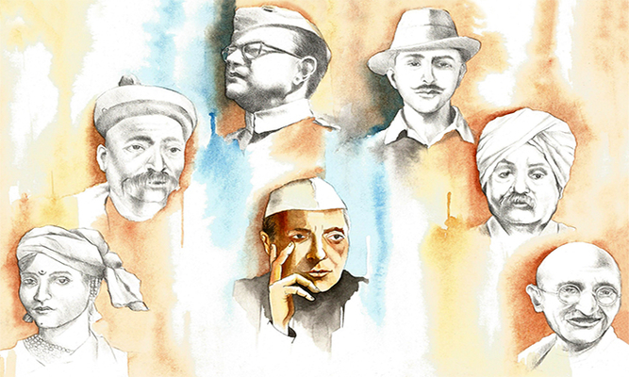
Glimpses of the Past MODULE 2
From Our Freedom Movement
S D SAWANT

Slide 2
4.Raja Ram Mohan Roy(1772-1833)
Ram Mohan Roy , a learned man from Bengal, tried to reform the society. He taught people that the main precepts of all religions were the same. He emphasized the practical and scientific use of knowledge. He went to England. He reminded the British that rulers too had duty towards their subjects. He started newspapers but the suspicious British stopped them in 1823.

Slide 3
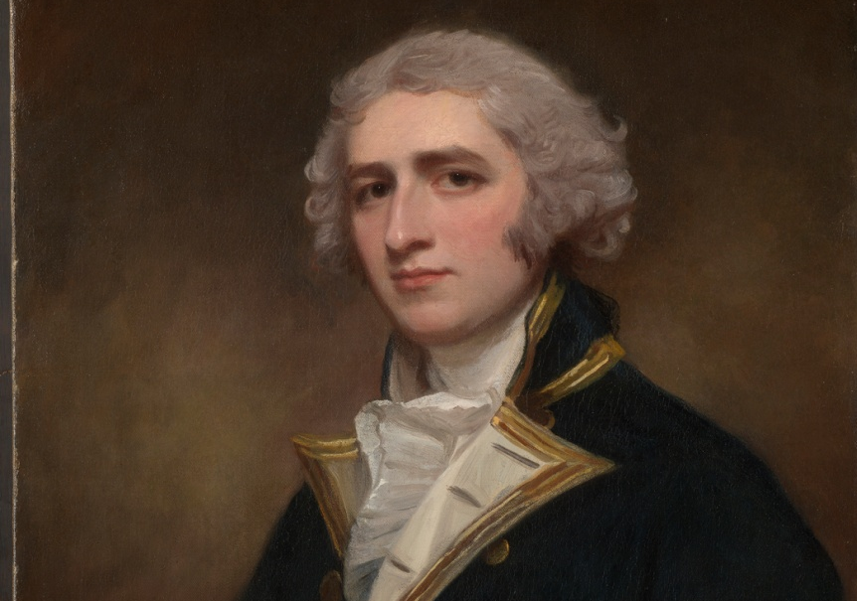
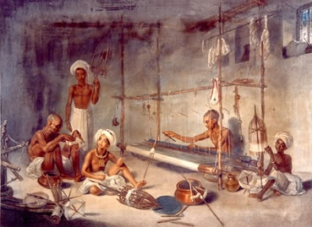
5. Oppression(1765-1835)
In 1818, a resolution was passed. Under it an Indian could be jailed without trial in a court. The British officers drew large salaries. They made fortunes in business. By 1829, Britain was exporting British goods worth seven crores rupees to India. The British Governor General of India, Bentinck reported to England – “the bones of cotton weavers are bleaching the plains of India.” Thus the British prospered on the ruins of Indian industry.
Lord William Bentinck

Slide 4
6. Dissatisfaction (1835-56)
1.

Slide 5
6. Dissatisfaction (1835-56)
2. In 1835, Lord Macaulay suggested that the medium of education in India should be English. The aim was to produce an army of clerks to assist the British. Incidentally, it also produced a new generation of intellectuals.
Some of them tried to educate the masses. Some decided to convey the grievances of the people to the British Parliament.
Lord Macaulay

Slide 6
Exercise for Practise (II)
Name these people
(i). Name the ruler who fought pitched battles against the British and died fighting.
(ii). The person who wanted to reform the society.
(iii). The person who recommended the introduction of English education in India

Slide 7
Exercise for Practise (III)
Mention the following :
(i). Two examples of social practices prevailing then.
(ii). Two oppressive policies of the British.
(iii). Two ways in which common people suffered.

Slide 8
Multiple Choice Questions
Ram Mohan Roy, a learned man from Bengal tried to ____________
(i). Reform our society
(ii). Started newspapers
(iii). Both (i) and (ii)
2. Who quote these words – ‘ cows are of different colours, but the colour of their milk is same. Same way the essence of every religion is the same.’
(i). Macaulay
(ii). Bentinck
(iii). Ram Mohan Roy

Slide 9
3. Regulation III means:
(i). Any Indian could be jailed without a trial in a court
(ii). British goods imported to India were to be duty free.
(iii). Equal salary to be given to Indians and British soldiers alike.
4. The first Governor General of India was –
(i). Macaulay
(ii). William Bentinck
(iii). Dalhousie

Slide 10
5. English educationwas introduced in India by _____
(i). Macaulay
(ii). Lord Cripp
(iii). Dalhousie
6. By 1856, the British had conquered _________
(i). The whole of India
(ii). Eastern part of India
(iii). Western part of India

Slide 11
End of Module 2

